Slide 1

EaTogether
Anran Guo
Lu Zhang
Mi Youn Song

Slide 2


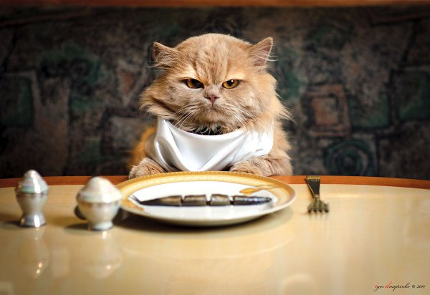
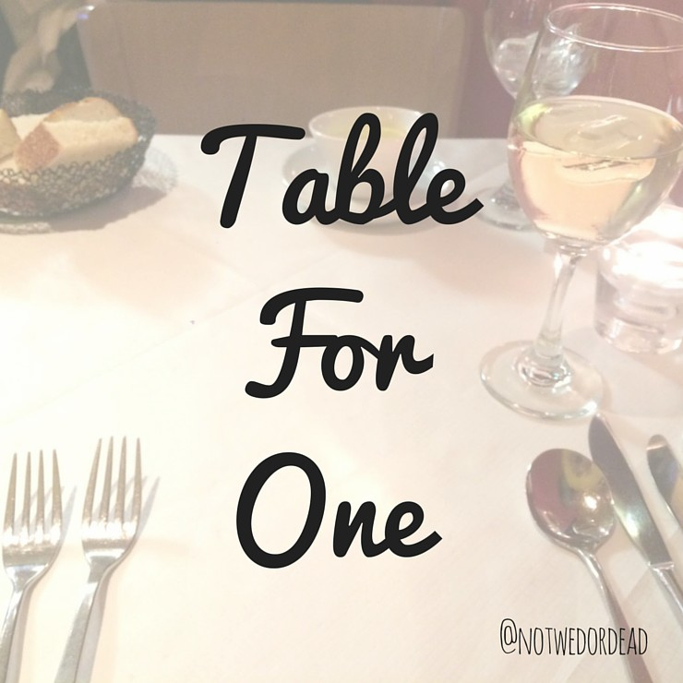
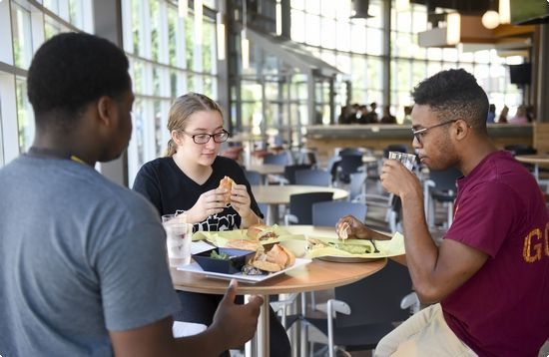
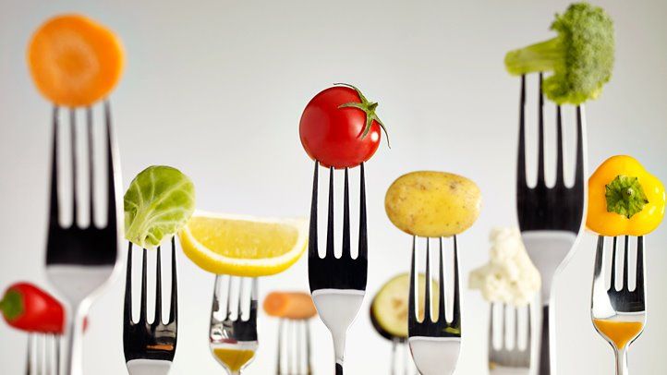
1
introduction

Slide 3
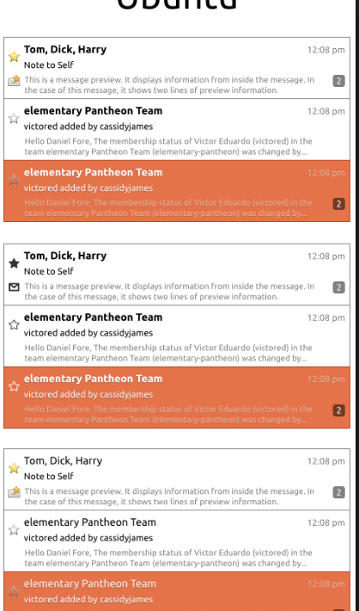
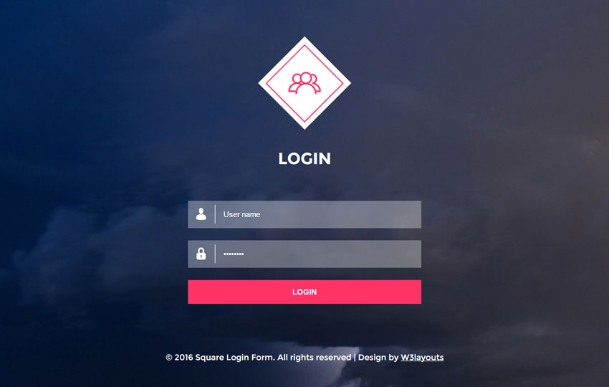
Login
Create posts
View meal nearby and Join a meal
Review meal
View previous meal
Chat online
Choose a topic
Function model
2
Notes:
->usc email
->Create posts
The posts will include the schedule of the meal, and max number of the participants ,location ， after the actual number is up to the maximam, the others
Cannot join
->Chat online is to be determined
->choose topic arouse interest

Slide 4
Interface : Web browser
Language : Python, JavaScript
Database : Firebase
Sample Data types:
Personal information – USC id, name
Post information – post id, host, title, time, location, member#,
participants, preference
Review – review id, post id, writer, contents
3
Implementation

Slide 5
EaTogether
makes your life better!

